Slide 1

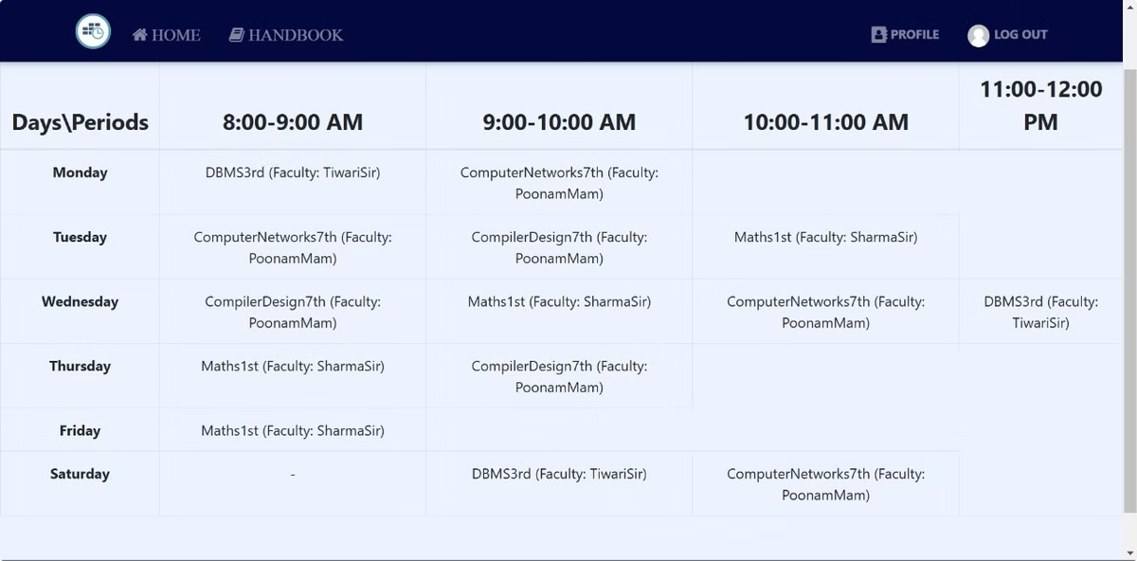
Automatic Timetable Generator
Streamline the creation of timetables for educational institutions with our efficient and user-friendly web application.
Utilizing advanced technologies such as React.js for dynamic interfaces, Node.js for backend operations, and MongoDB for secure data storage
this project ensures accurate and error-free scheduling. Features include automated conflict resolution, secure user authentication , and an intuitive interface for timetable visualization. This solution not only saves time but also reduces manual errors, making scheduling seamless for administrators.

Slide 2
Problem Statement
1
Manual Timetable Creation
2
Inefficient Resource Allocation
3
Lack of Transparency
Manual timetables are often difficult to navigate, making it challenging for students and faculty to find the information they need.
Traditional timetable creation is a time-consuming and error-prone process, often leading to scheduling conflicts and student dissatisfaction.
Manual timetables frequently result in uneven distribution of resources, leading to overcrowded classrooms and underutilized facilities.
4
Lack of Scalability
5
Challenges in Accessibility
Manually generated timetables struggle to adapt to increasing class sizes or additional constraints in growing institutions.
Paper-based or static digital timetables are hard to update and share, reducing transparency for teachers and students.

Slide 3

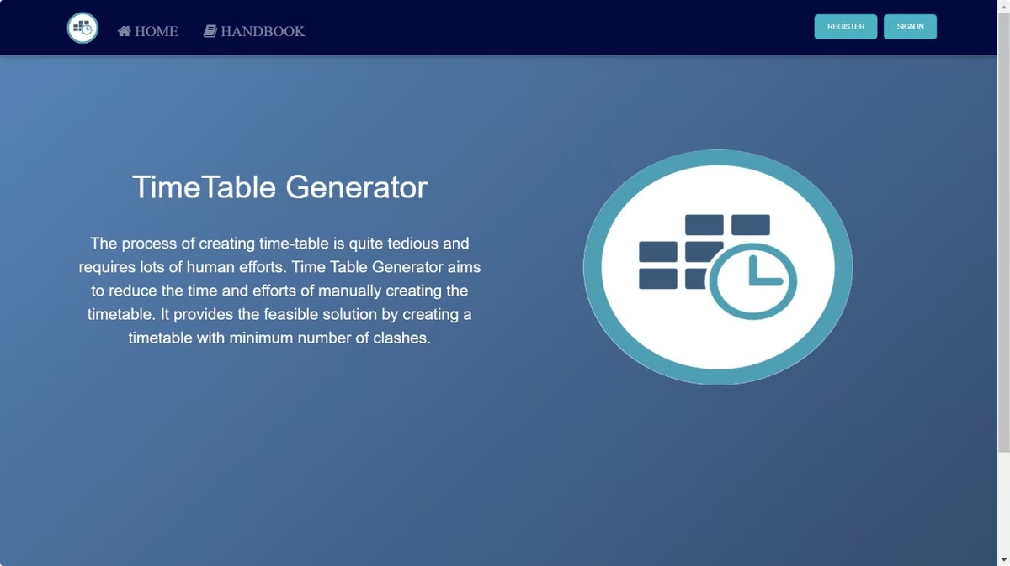
Objective
Automated Timetable Generation
Automate the timetable creation process, eliminating manual errors and reducing the time required for scheduling.
Optimized Resource Allocation
Develop an algorithm that efficiently allocates resources, ensuring optimal utilization of classrooms and faculty time.
User-Friendly Interface
Create a user-friendly interface that allows users to easily navigate and understand the generated timetables.

Slide 4

Simplify Updates and Modifications
Provide a flexible system to accommodate last-minute changes, such as teacher substitutions or room reallocations.
Improve Efficiency and Accuracy
Replace manual efforts with an accurate, fast, and user-friendly automated solution.

Slide 5
Technologies Used
Node.js: Used in the backend to handle server-side logic, such as processing timetable requests.
Express.js: Used in the backend to set up APIs that connect the frontend and backend, handling requests and responses.
MongoDB: Used as the database to store user data, timetable configurations, and scheduling information.
JWT (JSON Web Tokens): Likely implemented for securing user authentication, ensuring that only authorized users can access certain features of the project.
React.js: Likely used in the frontend for creating the user interface where users can input details and view generated timetables interactively.

Slide 6

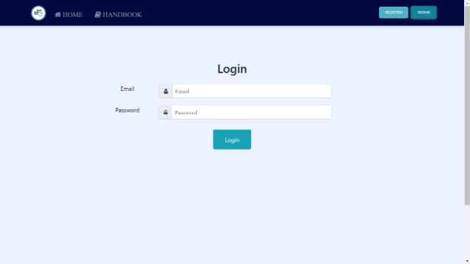

Features
User Login
Secure user authentication using JWT for authorized access to the system.
Timetable Generation
Automated generation of timetables based on user-defined preferences and constraints.

Slide 7




Conflict Resolution
Intelligent algorithm to detect and resolve scheduling conflicts, ensuring a feasible timetable.
Visual Timetable Display
Interactive and user-friendly display of the generated timetable, with clear visualization of class schedules and locations.
User-Friendly Dashboard
Create an intuitive dashboard for users to view, edit, and manage timetables.
Scalability
Time table generator website can create vast time table

Slide 8
System Workflow
1
User Input
Users provide details like courses, preferences, and availability.
2
Timetable Generation
The system processes input and generates a feasible timetable using optimized algorithms.
3
Conflict Resolution
The system detects and resolves any scheduling conflicts, ensuring a valid timetable.
4
Timetable Display
The generated timetable is displayed in a user-friendly format, allowing for easy navigation and understanding.

Slide 9
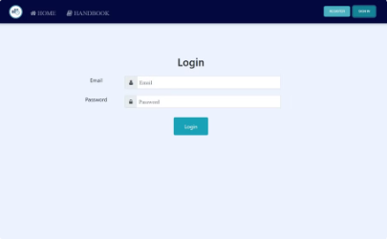
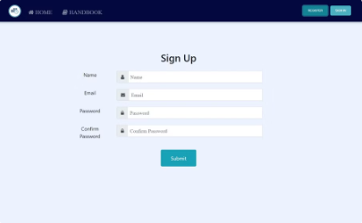
Screenshots
Login Page
A secure login page for user authentication, ensuring authorized access to the timetable generator.
sign up
user have to first sign up

Slide 10
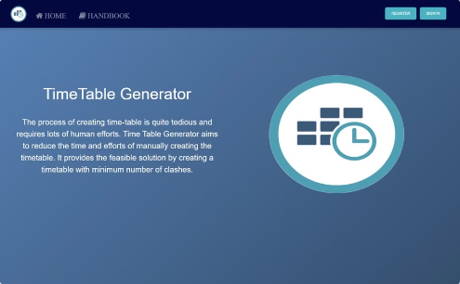
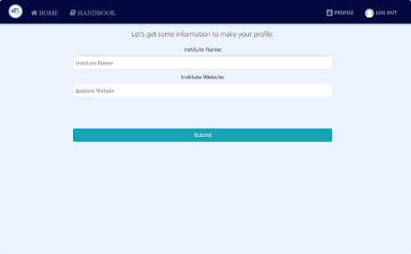
Home page
before login user will see this page
Profile
user can make profile at this page

Slide 11
Challenges
Algorithm Design
Developing an efficient and robust algorithm to handle complex scheduling constraints and ensure optimal timetable generation.
Data Management
Efficiently storing and retrieving large volumes of course and faculty data for accurate timetable generation.
Scalability
Ensuring the system can handle the increasing demands of larger institutions and diverse scheduling requirements.

Slide 12
Limitations and Future Scope
1
Multi-Time-Table Support
2
Role-Based Access
Extend the system to cater to multiple institutions, allowing for seamless timetable generation for diverse environments.
Implement different user roles (admin, teacher, student) with specific access permissions.
3
Enhanced User Interface
4
Limited Constraint Handling
Introduce a more dynamic and visually appealing UI for improved user experience.
The system may not accommodate complex constraints like multi-campus scheduling or extracurricular activities.
5
Dependence on Accurate Input The timetable's accuracy depends heavily on the precision of the user-defined data and constraints.
6
Multiple tables cant be generated
Multiple tables at the same time can't be generated

Slide 13
Conclusion
The Automatic Timetable Generator revolutionizes timetable creation, offering significant time savings and error-free scheduling for educational institutions. The system's user-friendly interface, optimized algorithms, and secure authentication ensure efficient and effective timetable management, ultimately enhancing the learning experience for students and faculty.

